Slide 1

Shah and Anchor Kutchhi Engineering College SIGN LANGUAGE RECOGINITION Submitted by- Guide- Prof. karuna borhade Co-GUIDE- PROF. VANDANA SONI
NAME | CLASS | ROLL NO.
Jay Karolia | TE-9 | 22
Kashyap Kurani | TE-9 | 25
Chintan Rajgor | TE-9 | 34
Ananya Tripathi | TE-9 | 56

Slide 2
content
ABSTRACT
INTRODUCTION
OBJECTIVES
LITERATURE SURVEY
REQUIREMENTS
PROPOSED METHODOLOGY
RESULT ANALYSIS
FUTURE SCOPE
REFERENCES

Slide 3
ABSTRACT
Those who suffer from being deaf and have impaired hearing should not be sheltered from communicating with the rest of their peers.
Just because a portion of the population cannot hear or speak, does not mean that their form of communication should not advance along with the rest of the world.
Sign language is how the hearing impaired express their feelings, contribute to a conversation, learn, and overall live their lives as normal as possible.
Being that it is 2021 and there are widespread pushes toward equality and inclusion, sign language should be included in this worldly push.
Having sign language courses readily available to students will further enhance this push toward achieving complete inclusiveness.

Slide 4
INTRODUCTION:
Our project is a software that is used for recognizing SIGN LANGUAGE.
The importance of sign language is gaining momentum, finally, and it is evident that more people are seeing the need for it in today’s society.
Recognition of sign language can be done in two ways, either glove based recognition or vision based recognition.
Our project is on the basis of static type vision-based recognition.
In static recognition system, the input may be an image of hand pose, that provides only a 2D representation of the gesture.
This project is created using PYTHON.
We have also used KERAS, TENSORFLOW and OpenCV 3.

Slide 5
OBJECTIVES:
This system, real-time sign language recognition system is made for recognising the words of Sign Language.
It will be producing 98% accuracy in labelling signs and this is somewhat higher than the similar existing systems.
The developed system is capable of recognising all alphanumeric letters and certain words of SL in real-time.

Slide 6
LITERATURE REVIEW:
SR.NO | TITLE | Publication | YEAR | DESCRIPTION | Drawbacks
1 | Real Time Recognition of Indian Sign Language | IEEE | 2019 | It uses dyanamic non-invasion vision method to get realtime video as input and then use contours to extract face and both hands and given gesture id and it is compared with previously recorded gestures. | They have use Fuzzy c-means algorithm instead of commonly used CNN algorithm which is easy to implement.
2 | Hand Gesture Recognition for Indian Sign Language using Skin Color Detection and Correlation-Coefficient algorithm with Neuro-Fuzzy Approach | IEEE | 2019 | In this paper authors have to choose to use correlation-coefficient algorithm with neuro-fuzzy approach rather than CNN model. | This system do not take real time video as an input it take images as an input so the words that can be predicted are also limited.
3 | SIGN LANGUAGE INTERPRETER HAND USING OPTICAL-FLOW | IEEE | 2016 | This method uses optical flow technique formed by Lucas-Kanade Algorithm. This algorithm is basically used to find derivation of light intensity. | It has Low accuracy compared to most of the other existing systems.
4 | Sign Language Detection from Hand Gesture Images using Deep Multi-layered Convolution Neural Network | IEEE | 2019 | This method uses multi-layered CNN to recognize both static as well as dynamic gestures. | Their is pre-processing of image which takes the hand-signs from a constant image and places it in a noisy background for the input, which improves the accuracy of detection but is slow compared to the other existing systems.

Slide 7
Requirements:
SOFTWARE:
Microsoft Visual Studio 2010
Python 3
Tensorflow
Keras
OpenCV 3
HARDWARE:
Hard Disk minimum of 40 GB.
RAM minimum of 2 GB.
Dual Core and up ,15” Monitor.
Integrated webcam or external webcam (15 -20fps)

Slide 8
PROPOSED METHODOLOGY:
IT CONSISTS OF 3 STEPS:
CAPTURING HAND-SIGNS AS IMAGES AND STORING IN DATABASE.
TRAINING THE CNN (CONVOLUTION NEURAL NETWORK) MODEL IN SUCH A MANNER THAT IT EXTRACTS THE HAND-SIGNS FROM THE STORED IMAGES.
IT COMPARES EXTRACTED HAND-SIGN FROM REAL-TIME IMAGE WHICH IS GIVEN AS INPUT AND PROVIDES THE MEANING OF HAND-SIGNS IN THE FORM OF TEXT.

Slide 9
CNN Algorithm:
A Convolutional Neural Network is a Deep Learning algorithm which can take in an input image, assign importance to various aspects/objects in the image and be able to differentiate one from the other.
CNN is a mathematical construct that is typically composed of three types of layers (or building blocks): convolution, pooling, and fully connected layers. The first two, convolution and pooling layers, perform feature extraction, whereas the third, a fully connected layer, maps the extracted features into final output, such as classification.

Slide 10
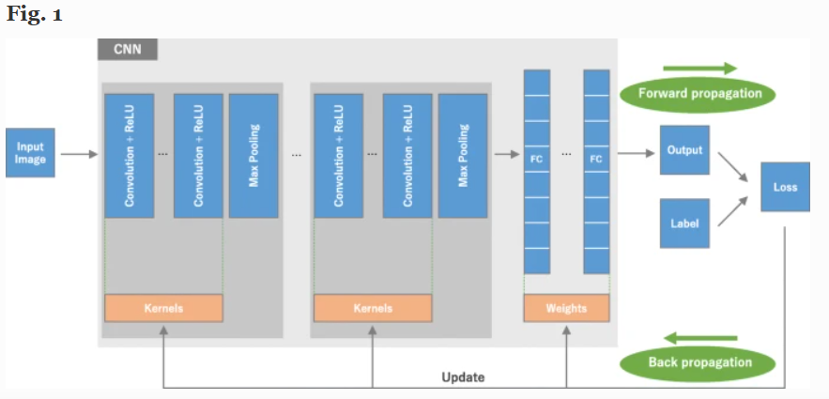
Cnn flowchart

Slide 11
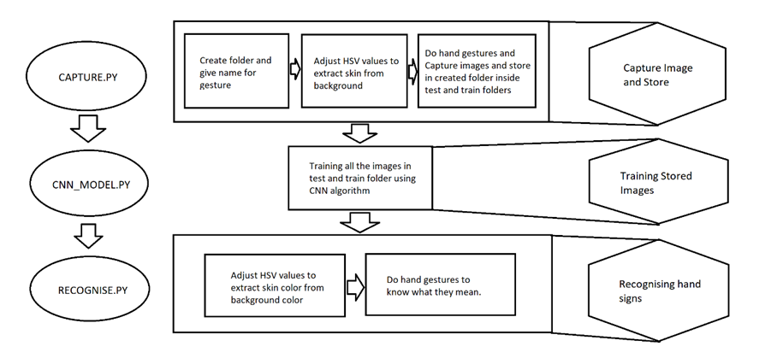
FLOWCHART:

Slide 12
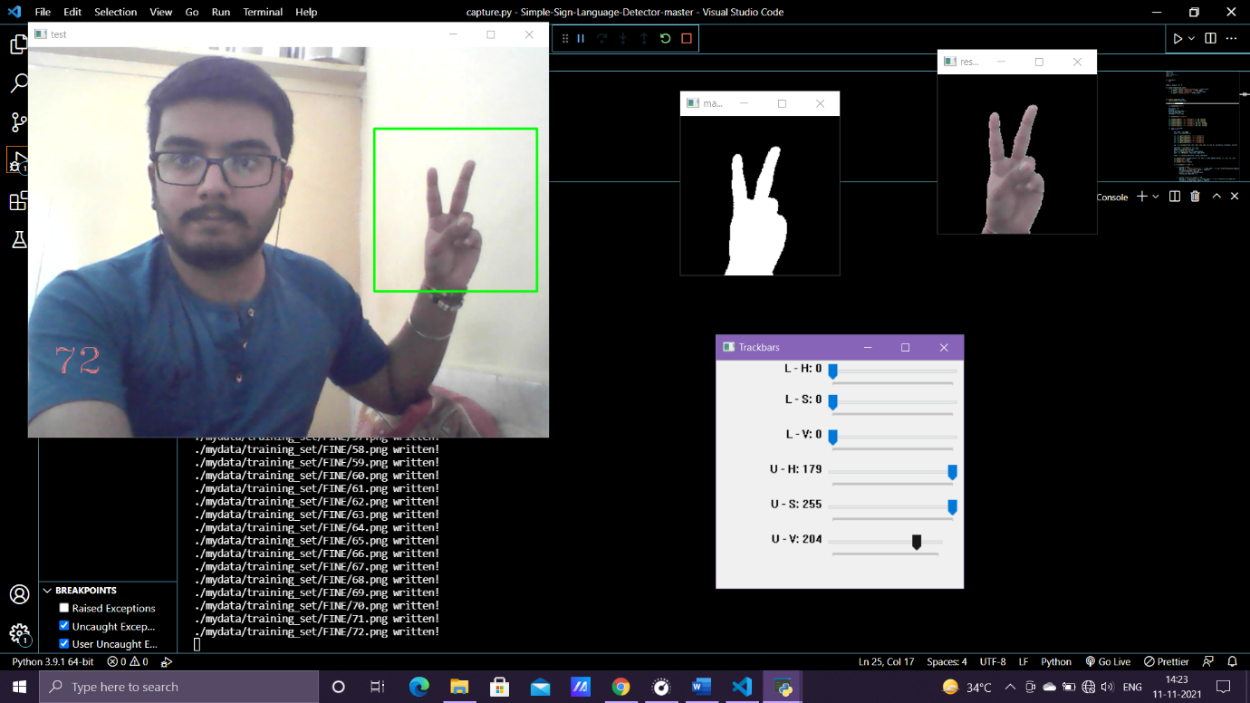
Result and analysis:
1. We have Successfully captured and stored images with capture.py

Slide 13
Result and analysis:
2. We have Successfully Trained Images with CNN model

Slide 14
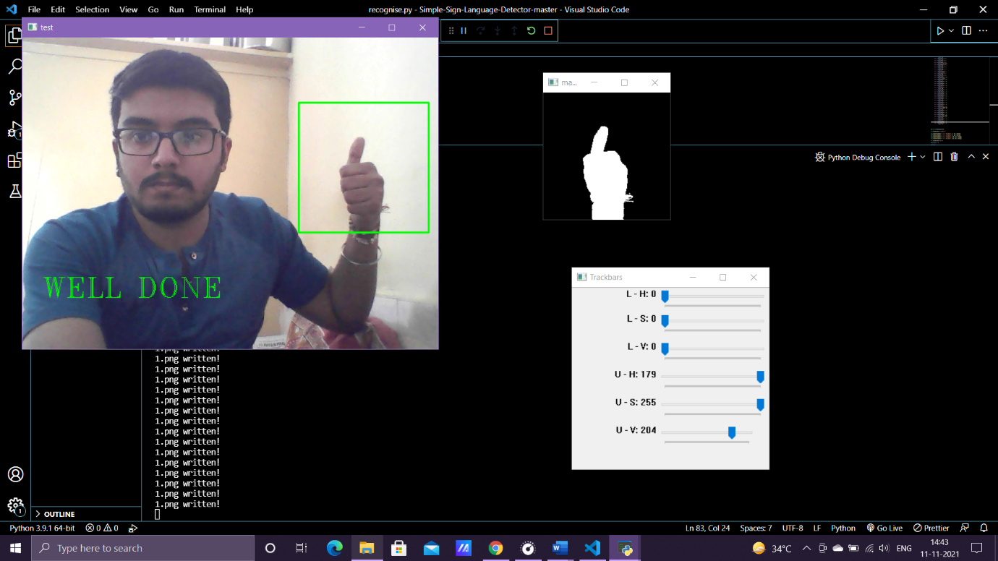
Result and analysis:
3. Now we have Identified Signs and Predicted the Meaning with Recognise.py successfully

Slide 15
FUTURE SCOPE:
The hand gesture recognition system can be used further to control the operation of other system applications like Explorer, Media Player etc.
To create a website which operates using hand gestures. JavaScript can be dynamically combined with the gesture recognition logic for the same.
To use the gesture recognition logic in sensitive areas of work like hospitals and nuclear power plants where sterility between machines and human is vital.
To create a battery free technology that enables the operation of mobile devices with hand gestures.

Slide 16
References:
https://ieeexplore.ieee.org/document/9036832
https://ieeexplore.ieee.org/document/9362897
https://ieeexplore.ieee.org/document/7873837
https://ieeexplore.ieee.org/document/8945850
https://ieeexplore.ieee.org/document/8862125
https://ieeexplore.ieee.org/document/8622141
http://talkinghands.co.in/
https://insightsimaging.springeropen.com/articles/10.1007/s13244-018-0639-9#Sec3

Slide 17
